Slide 1
Advanced Biological Control System

Slide 2

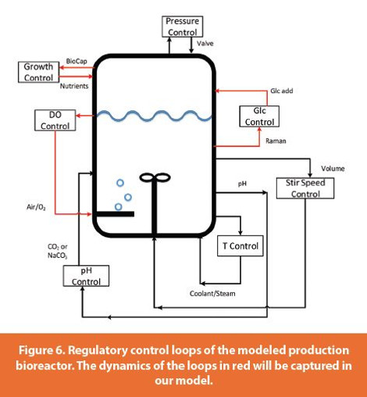
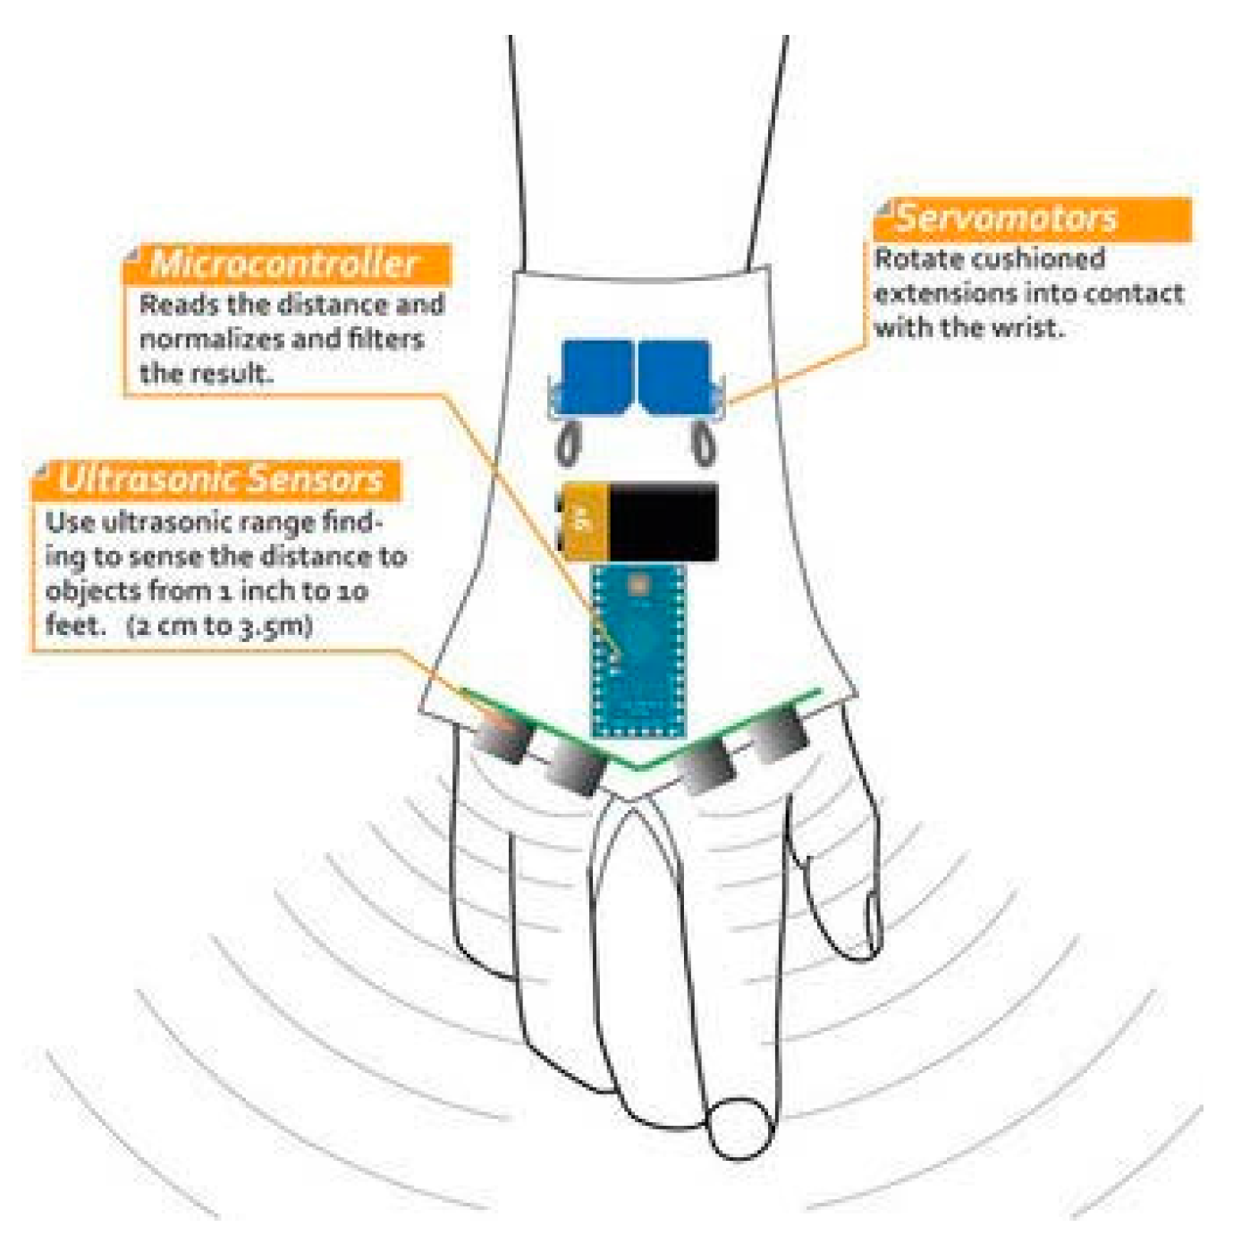
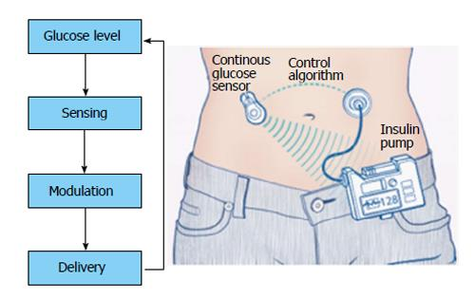



BIOEN 498/599: Advanced Biological Control Systems
Spring, 2022. MW 1:30 – 2:20, Friday 12:30 – 2:20.
Instructor: Joseph L. Hellerstein, Senior Fellow (eScience Institute), Affiliate Professor (Allen School of Computer Science)
jlheller@uw.edu
Bioreactor Control
Medical Device Control
Insulin Control
This course teaches students how to design systems that control chemical networks with applications to bioreactors, medical devices, and the analysis of biochemical networks. The course addresses controllability and observability of chemical networks, construction of state space feedback controllers, state observers, noise attenuation and disturbance rejection, and some elements of system identification. Some learning objectives are:
construct and analyze models of chemical networks in both continuous and discrete time;
analyze the controllability of chemical networks, and isolate controllable subparts of uncontrollable networks;
analyze the observability of chemical networks, and isolate observable subparts of unobservable networks;
control a chemical network using full state feedback;
implement robust control to address model inaccuracies and measurement noise.
Prereq: BIOEN 336 (Bioengineering systems & control) or equivalent.

Slide 3
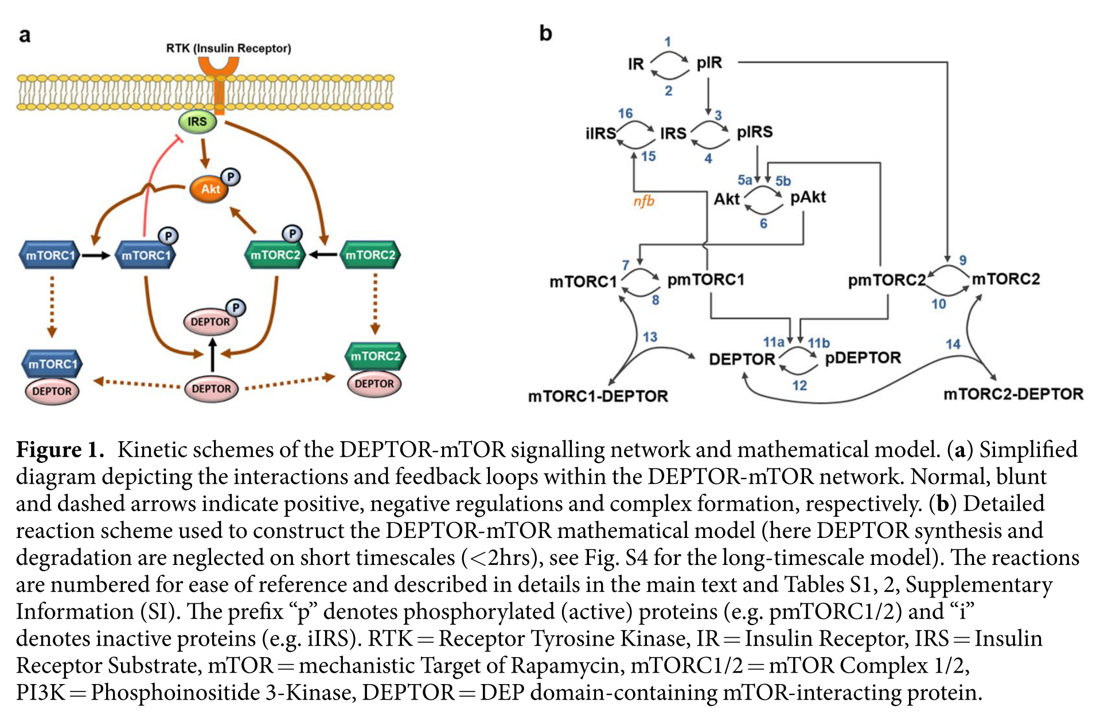
Insulin Receptor
Insulin Receptor
Substrate
or

